Slide 1
Interface for the Future
Bitly – Your All-in-one Voice Assistant App
Developed By :- Team BitByBit
Team Members :-
1.Upen Kumbhakar (CSE-28)
2.Pritideep Mahata (CE- 28)
3.Subhajit Maji ( ECE –28)
4.Abir Mandal ( CE-28 )
HACKVENGERS 2025

Slide 2
The Problem
Usage of Keyboards and Mouses are outdated
The world is getting all “contactless”
Accessibility remains a challenged for many Users

Slide 3
Our Solution
Voice Controlled Desktop Assistant
Automates mouse , Keyboard , apps, browser, and office
Fully customizable & works offline
Designed for real-world productivity use

Slide 4
Features
Mouse/Keyboard Control
Browser Navigation
Microsoft Office Automation
GUI With Settings and logs
Speech Feedback

Slide 5
What Makes Bitly special
Fully Offline , No Login
Superfast and customizable
Helps in accessibility and and real-world usage
GUI With Settings and logs
Modular and extendable

Slide 6
Tech Stack
Frontend : CustomTkinter
Voice : pyttsx3,speechRecognition
Backend Logic : Python, PyAutoGUI,Win32 APIs
Utilities: psutil, winreg,webbrowser
Modular and extendable

Slide 7
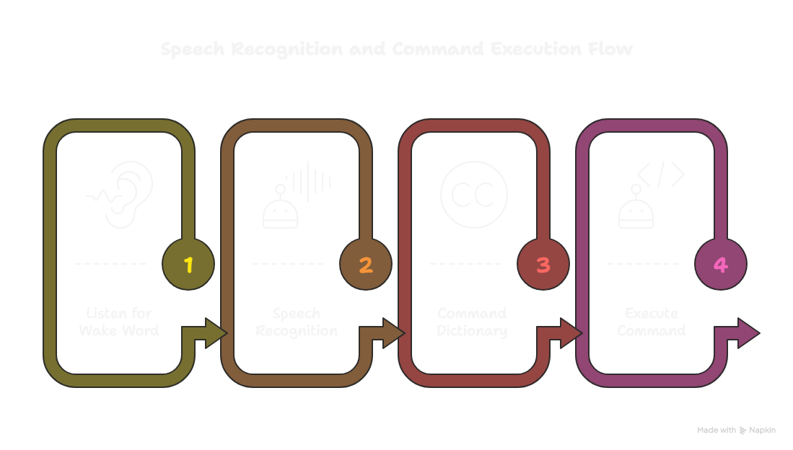
Command Flow Diagram

Slide 8
Future Scope
Gesture based controls can be implemented
Multilingual Voice Assistance
Custom Command Training
API integrations ( Calendar , Mail )
Mobile and desktop sync
AI Integrations .

Slide 9
Thank You

